Slide 1


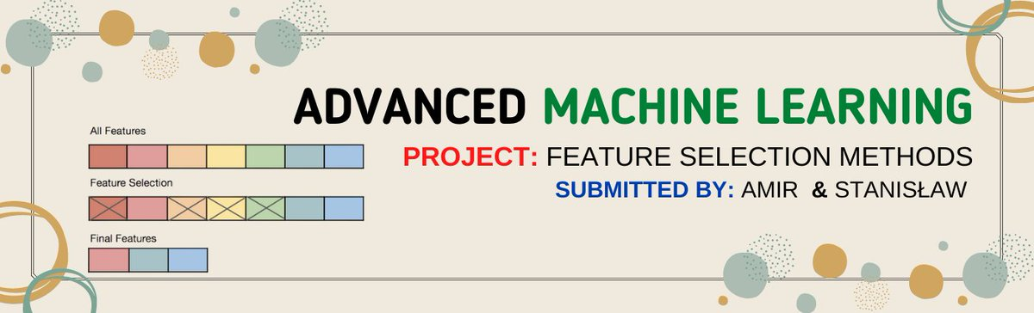
Warsaw University Of Technology
Faculty of Mathematics and Information Science

Slide 2
Outline
Dataset Information
Data Preprocessing
Classification Techniques
Feature Selection Techniques
Results
Reference

Slide 3
Dataset Information
Artificial Dataset: There are 2000 items. There are 500 predictor variables. The variable to predict is encoded as 0 or 1. There are 600 observations to predict in the validation dataset.
Digits Dataset: There are 5000 items, each having 6000 predictor variables. The variable to predict is equal to `4` or `6`. There are 1000 observations to predict in the validation dataset.

Slide 4
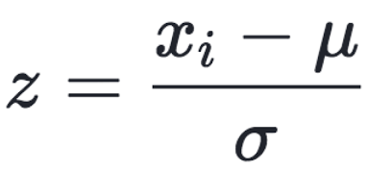
Data Preprocessing
Feature Scaling [1]
Standard Scaler

Slide 5
Classification Techniques
Logistic Regression
Quadratic Discriminant Analysis
Linear Discriminant Analysis
Random Forest Classifier
Support Vector Machine
XGBoost Classifier

Slide 6
Feature Selection Techniques
ANOVA F-value between label/feature – (SelectKBest)
FPR test – (SelectFpr)
Family-wise error rate – (SelectFwe)
Select from RandomForestClassifier model
* Kernel PCA – method=`rbf`

Slide 7
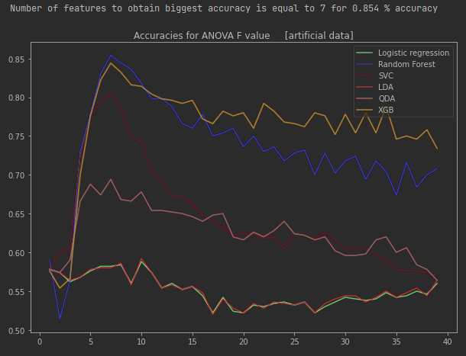
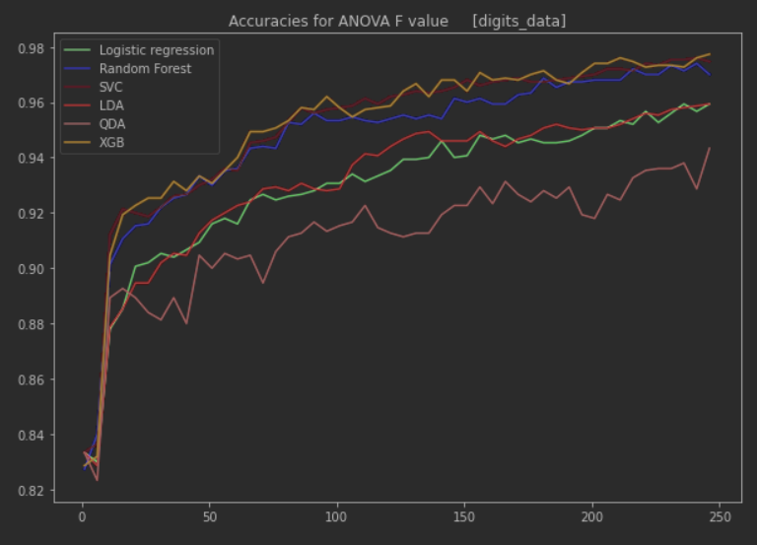
ANOVA F-value between label/feature – SelectKBest [3]

Slide 8
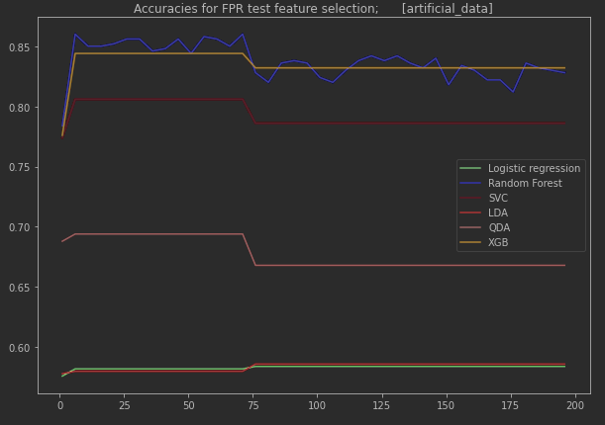
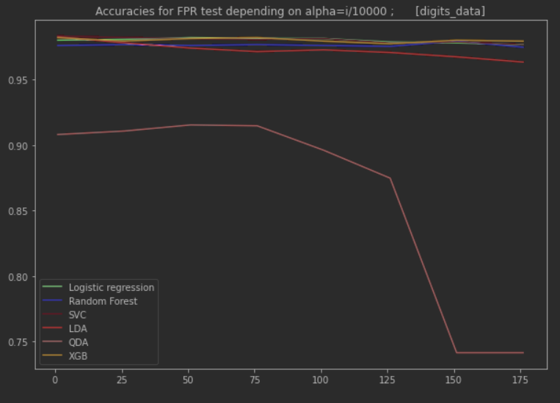
FPR test – Select FPR [5]

Slide 9
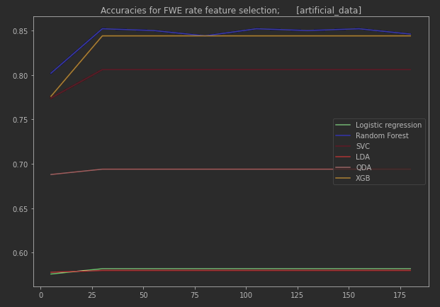
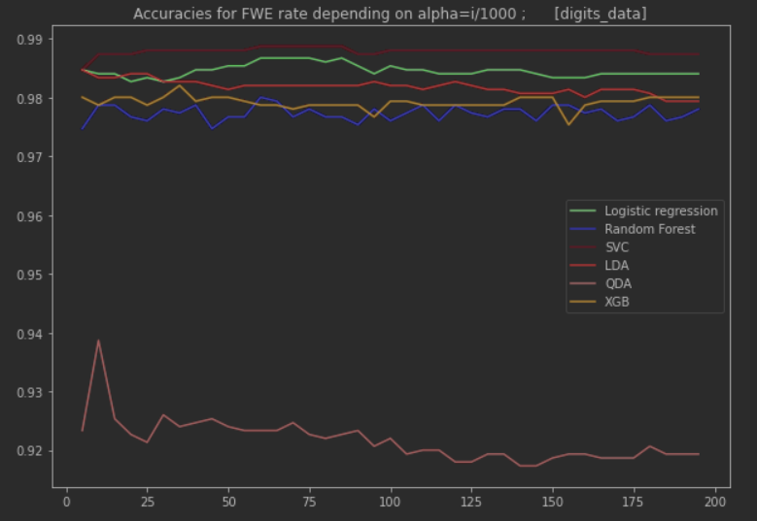
Family-wise error rate – (SelectFwe) [4]

Slide 10
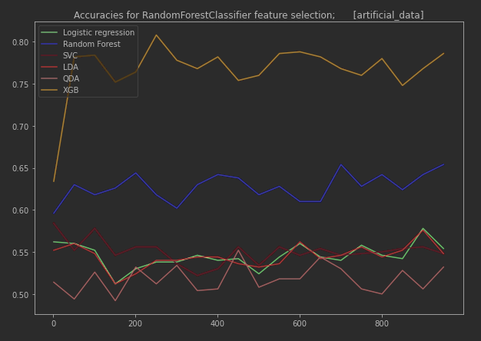
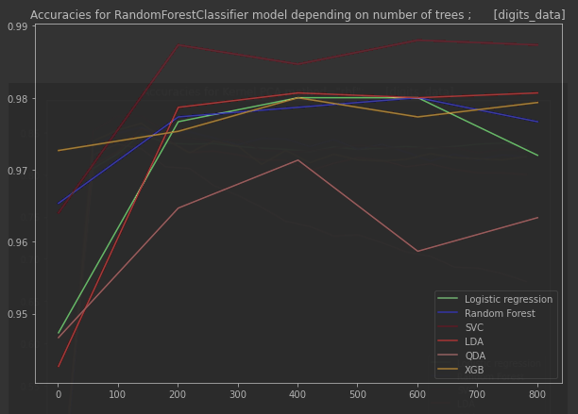
Select from RandomForestClassifier model [6][7]

Slide 11
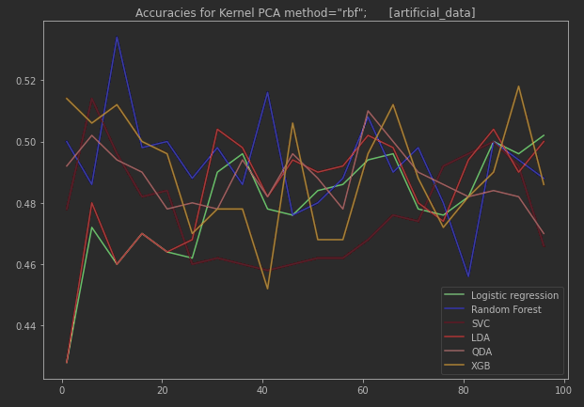
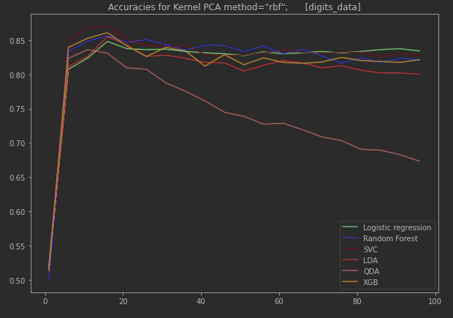
Kernel PCA [8]

Slide 12
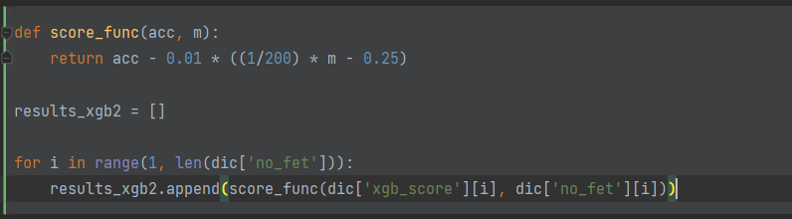
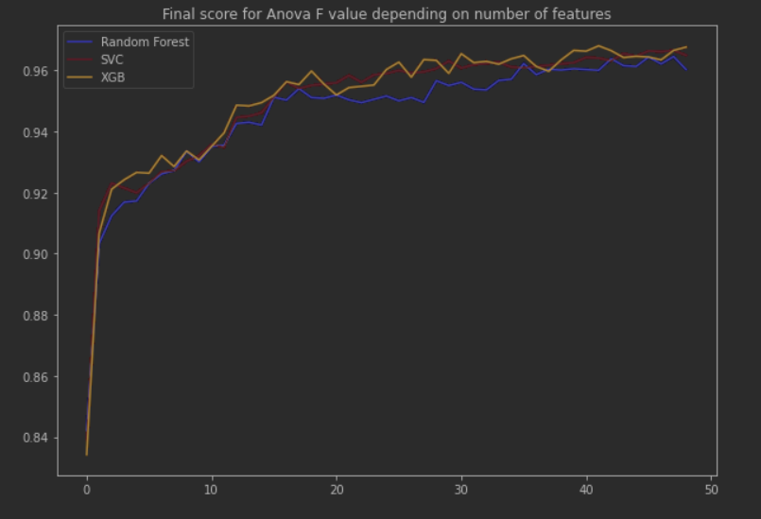
Final model selection [digits_dataset]

Slide 13
Reference
[1] https://scikit-learn.org/stable/modules/preprocessing.html
[2] https://scikit-learn.org/stable/modules/generated/sklearn.model_selection.train_test_split
[3] https://scikit-learn.org/stable/modules/generated/sklearn.feature_selection.SelectKBest.html
[4] https://scikit-learn.org/stable/modules/generated/sklearn.feature_selection.SelectFwe.html
[5] https://scikit-learn.org/stable/modules/generated/sklearn.feature_selection.SelectFpr.html
[6] https://scikit-learn.org/stable/modules/generated/sklearn.feature_selection.SelectFromModel.html
[7] https://scikit-learn.org/stable/modules/generated/sklearn.ensemble.RandomForestClassifier.html
[8] https://scikit-learn.org/stable/modules/generated/sklearn.decomposition.KernelPCA.html

Slide 14
Thank You☺

